Slide 1

Mini Project On Password Generator
Submitted By
Shubhangi Rai
Utsav Giri
Mukul Pandey

Slide 2

Password Generator in Python: A Practical Guide
Tired of weak passwords? This presentation guides you through building a powerful Python password generator. We'll cover security principles, coding techniques, and real-world applications.

Slide 3
Why Build a Password Generator?
Security
Convenience
Strong passwords protect your accounts from unauthorized access. A good password generator helps create complex and unique passwords.
Manually generating complex passwords can be tedious. A Python generator simplifies the process, allowing you to create secure passwords effortlessly.

Slide 4
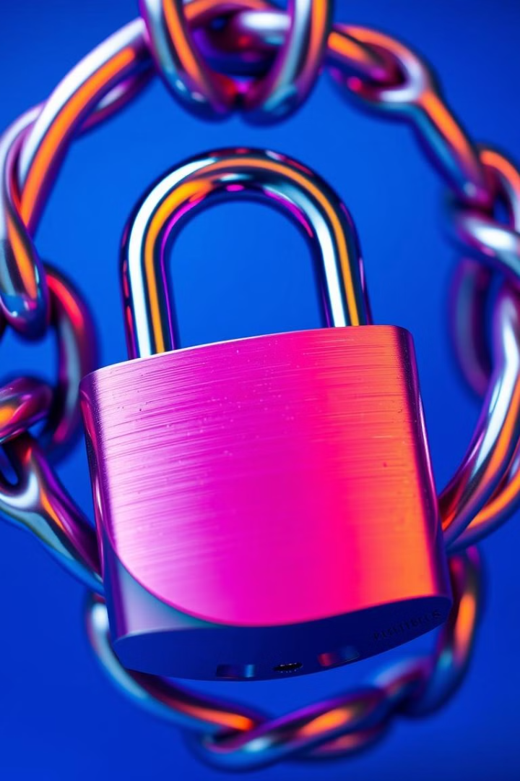
Key Requirements for Secure Passwords
1
Length
2
Diversity
A minimum of 12 characters is recommended, longer is better.
Include a mix of upper and lowercase letters, numbers, and symbols.
3
Randomness
Avoid predictable patterns or personal information that could be easily guessed.

Slide 5
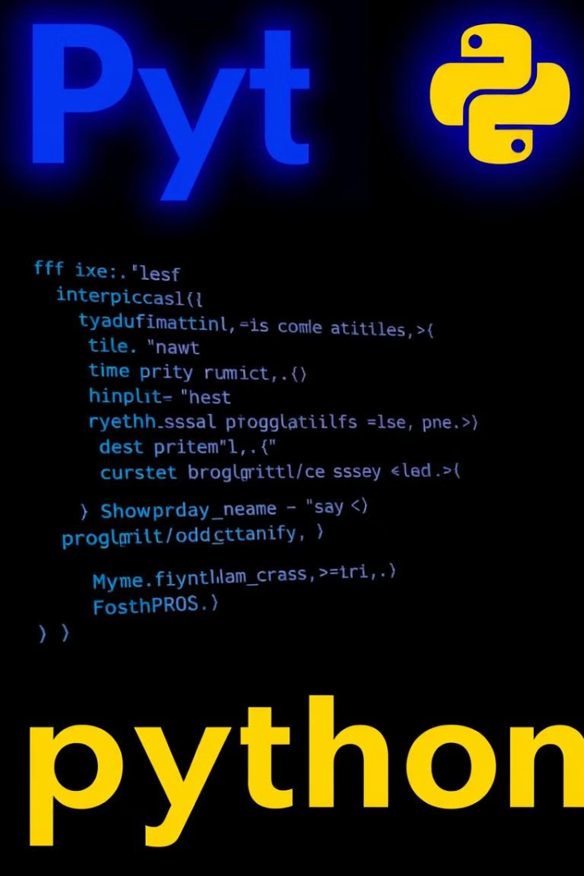
Building the Password Generator Step-by-Step
Import Modules
Define Character Sets
Begin by importing the necessary modules, including `random` for generating random characters.
Create variables for different character sets, such as lowercase letters, uppercase letters, numbers, and symbols.
Combine Sets
Combine the character sets to create a comprehensive pool of characters for the password.

Slide 6




Generating Random Characters
Random Function
Loop for Length
Concatenate Characters
Use the `random.choice()` function to randomly select characters from the combined set.
Iterate through a loop based on the desired password length.
Concatenate the randomly chosen characters into a complete password.

Slide 7
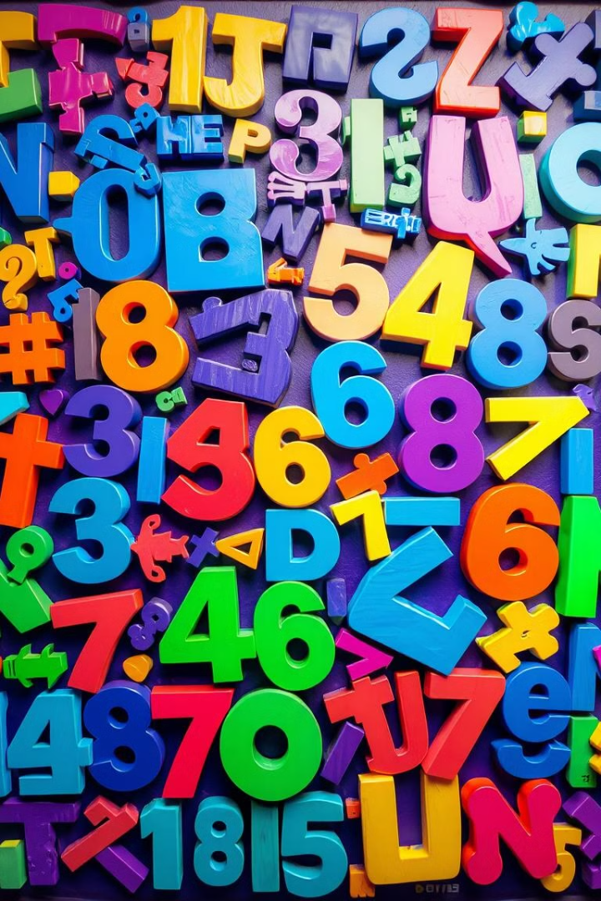
Combining Character Sets
1
Lowercase Letters
Include lowercase letters for alphabet diversity.
2
Uppercase Letters
Add uppercase letters for improved complexity.
3
Numbers
Incorporate numbers to enhance password strength.
4
Symbols
Introduce symbols for enhanced security.

Slide 8
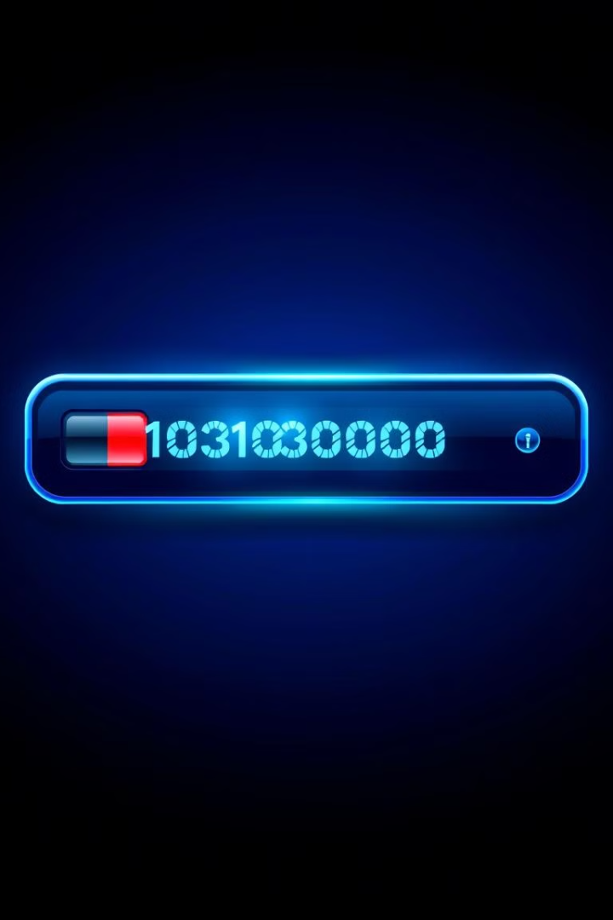


Password Length and Complexity
Length
Longer passwords are generally more secure. Aim for at least 12 characters.
Complexity
Include a mix of character types (lowercase, uppercase, numbers, symbols) to make it difficult to guess.

Slide 9



Conclusion and Next Steps
Secure Passwords
1
A password generator in Python empowers you to create strong, unique, and memorable passwords.
Customize
2
Experiment with different character sets and length variations to optimize password generation.
Protect
3
Store passwords securely and avoid using the same password for multiple accounts.

Slide 10

Thank You
Let me know if you have any questions! Happy coding!

